Slide 1
DESIGN AND IMPLEMENTATION OF A WEB-BASED FINAL YEAR PROJECT MANAGEMENT SYSTEM (FYPMS) (A CASE STUDY OF COMPUTER SCIENCE DEPARTMENT BABCOCK UNIVERSITY)
IZEVBIZUA SAMUEL EDOSA 19/1084
ADEKOYA DAMILARE ANOINTING 19/0095
OMAGE OMOLE NATHANIEL 19/1200
Group 14
Supervisor: Dr Ruth C. Amanze

Slide 2
Introduction / background
The use of web-based technologies and innovations in education sectors over the years have proven to offer benefits such as improved collaboration, reduced costs, and increased productivity, among other benefits.
Final-year projects carried out in higher institutions require a seamless exchange of information between students, supervisors, and project coordinators to meet institutional standards and deadlines so as to achieve stated goals.
At Babcock University, while the traditional manual system for managing final-year projects has produced good results, there are some drawbacks that have been identified such as time consumption, inconsistency leading to slow work rate leading to inefficiency.
The Final Year Project Management System (FYPMS) offers a web-based solution to streamline project workflows, improve communication, and provide a centralized platform for grading and submission of final year projects in order to increase effectiveness and consistency in project management between students and supervisors.

Slide 3
Aim & objectives
This system aim is to provide an effective, dependable, and user-friendly web-based platform that simplifies project supervision for final year projects in the department of Computer Science at Babcock University.
Objectives:
Provide a user-friendly online platform (website) for project management and supervision that facilitates better communication and collaboration between students and supervisors.
Increase the efficiency of final year project management and supervision by automating various processes and workflows.
Ensure that final year projects are completed on time and meet the required standards by providing structured deadline processes and a well organized platform for project management and supervision.

Slide 4
LITERATURE THAT WERE REVIEWED
Staff to student interactive platform.
The role and benefits of student tracking systems in higher education.
The need for a final year projects management system. →

Slide 5
The need for a final year projects management system
Three recent articles by Gomaa and Mohamed (2020), Iruka et al. (2019), and Olajubu et al. (2017) were examined to address the need for a Final Year Projects Management System in undergraduate education.
The authors of these articles conducted surveys and used an iterative design process to develop web-based platforms with features such as progress tracking, task scheduling, and communication tools to facilitate collaboration between students and supervisors.
Positive feedback from users was recorded, indicating that the system had improved the efficiency and effectiveness of project management. The implementation of a FYPMS was found as a lead to improve outcomes and increased student satisfaction.
The articles suggest that the use of technology, collaboration between students and supervisors, and centralized management are key factors in the success of a final year project management systems.

Slide 6
Some Gaps identified from these literature
Some gaps that were identified in order to improve the existing systems for final year project management systems include:
Use of messaging modules as an effective communication tool: This is crucial for the timely resolution of issues and for effective collaboration, especially in a remote or hybrid learning environment.
Limited support for collaborative work: Absence of platforms for sharing software development repositories can hinder effective collaboration between students and supervisors during the development phase.
Inefficient submission process: Submission modules are needed to provide a structured way for students to submit their work, increasing efficiency and reducing errors in the process.

Slide 7
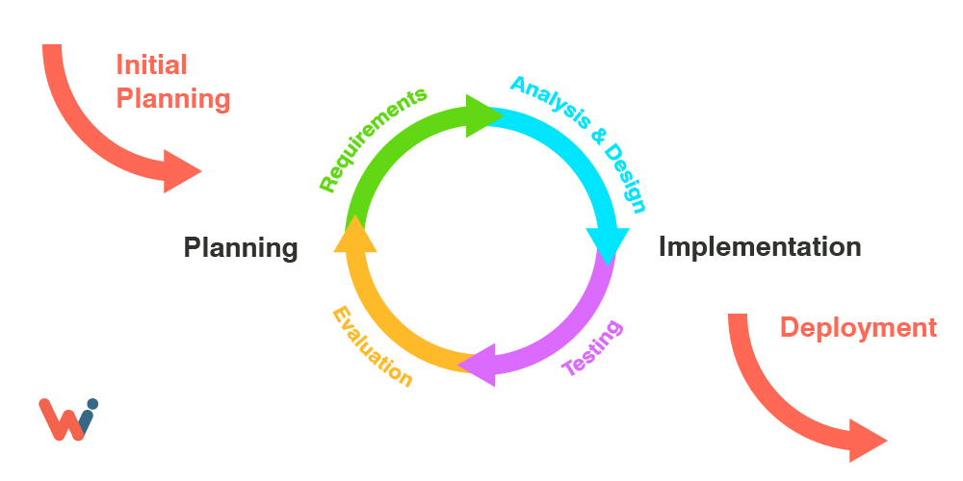
Research design model used
The iterative SDLC model was chosen for this project after a thorough examination of different SDLC models.
It involves a continuous cycle of planning, analysis, implementation, testing, and evaluation.
It was selected because of its ability to revert to earlier phases, its repetitive nature, and its less expensive effect on incorporating modifications at the early stage of software development/implementation.
The iterative model allows for flexibility in accommodating changes and modifications at any stage of the development process.
It allows for continuous feedback and evaluation, leading to the identification and resolution of issues early on in the project.
It helps to mitigate risks by breaking the project into smaller, manageable tasks and phases, reducing the overall complexity and uncertainty of the project.

Slide 8
Development tools
Programming/Scripting language: JavaScript
Frontend framework: React
Backend framework: Node.js and Express.js
Database systems: Mongoose and MongoDB
IDE: Visual Studio Code
Version Control System: Git

Slide 9
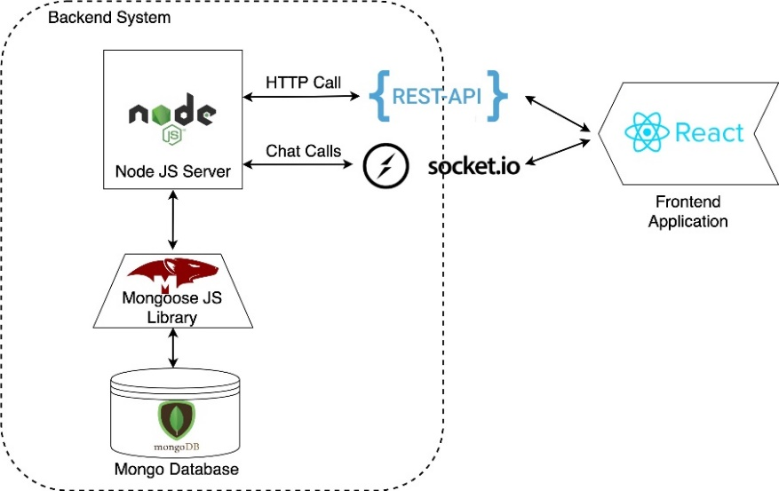
Logical architecture workflow of the system

Slide 10
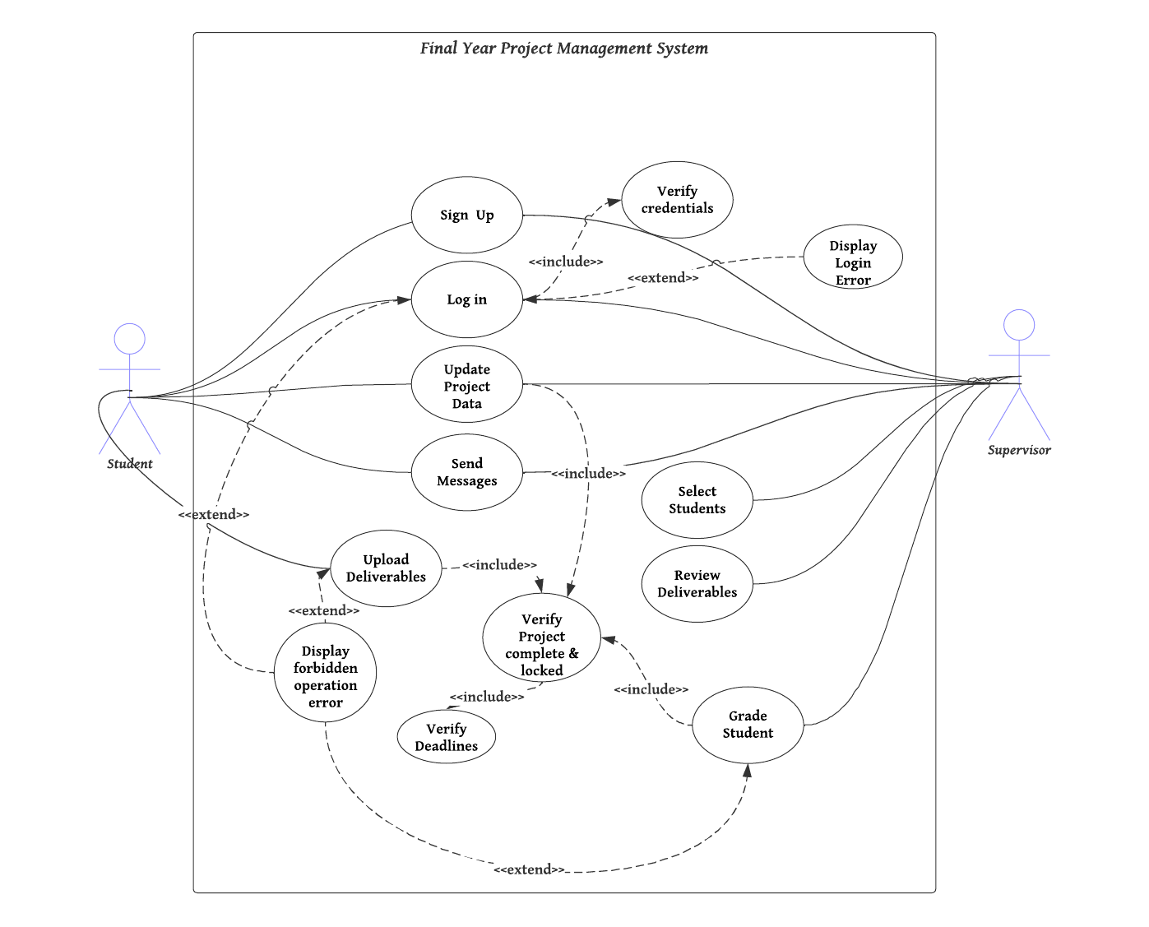
SYSTEM USE CASE DIAGRAM

Slide 11
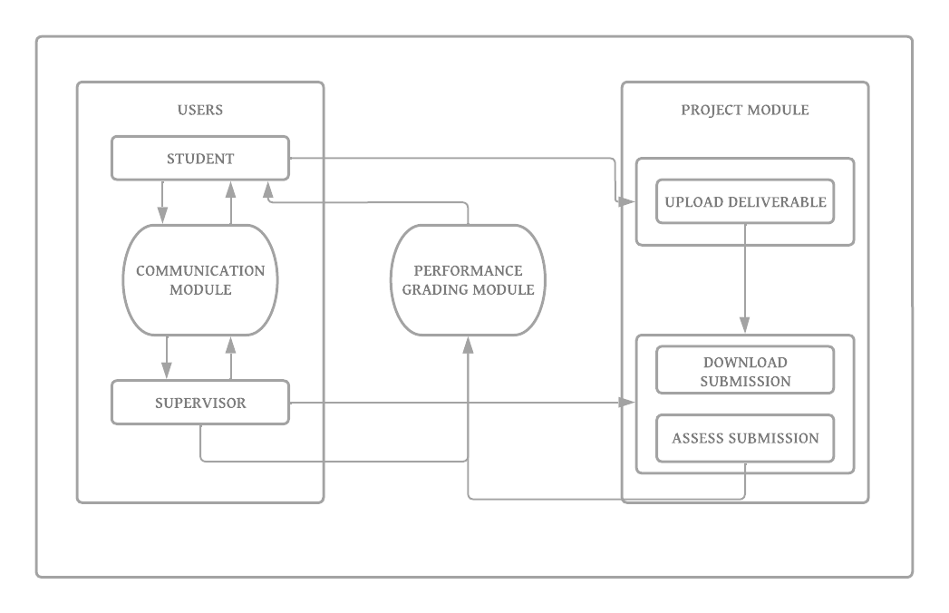
SYSTEM MODEL DIAGRAM

Slide 12
results

Slide 13
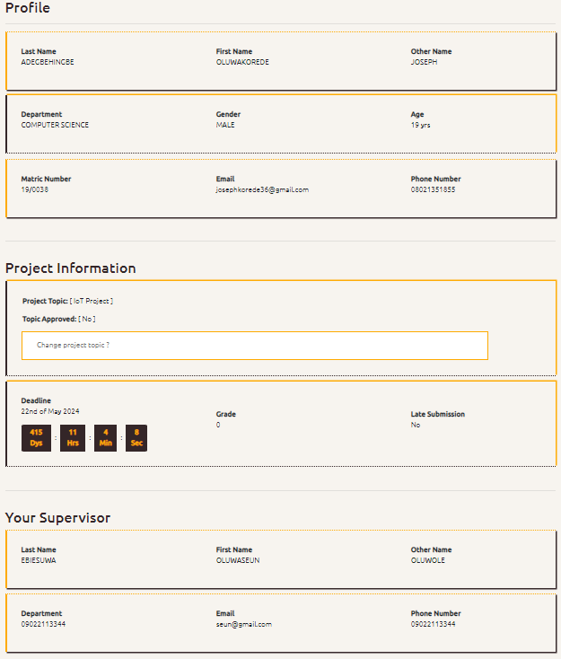
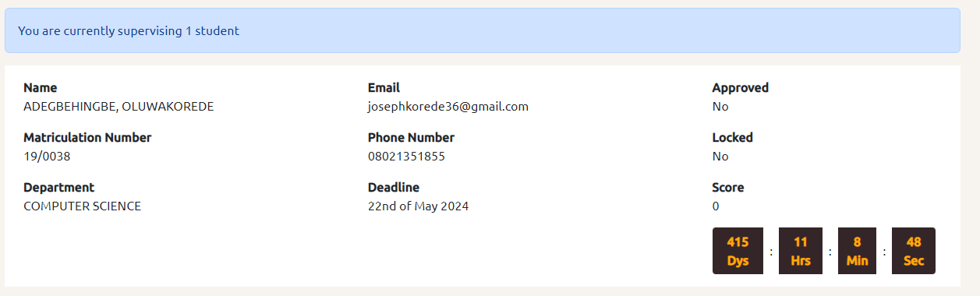
Supervisor students dashboard
Student profile page

Slide 14
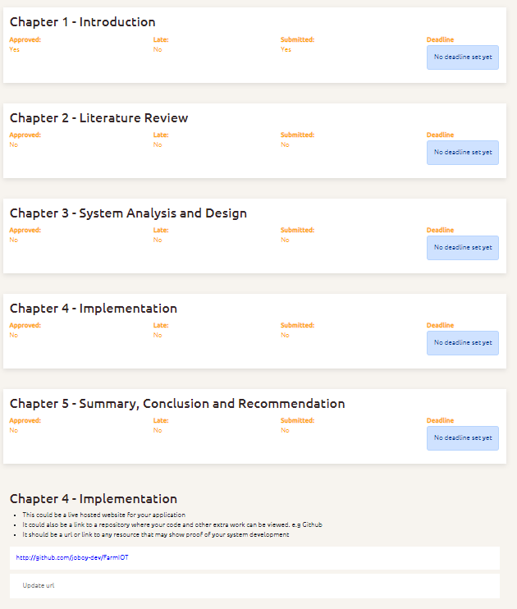
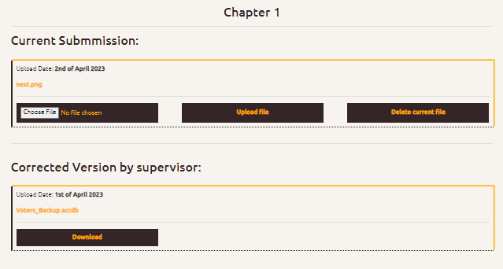
Supervisor students dashboard
Student project page

Slide 15
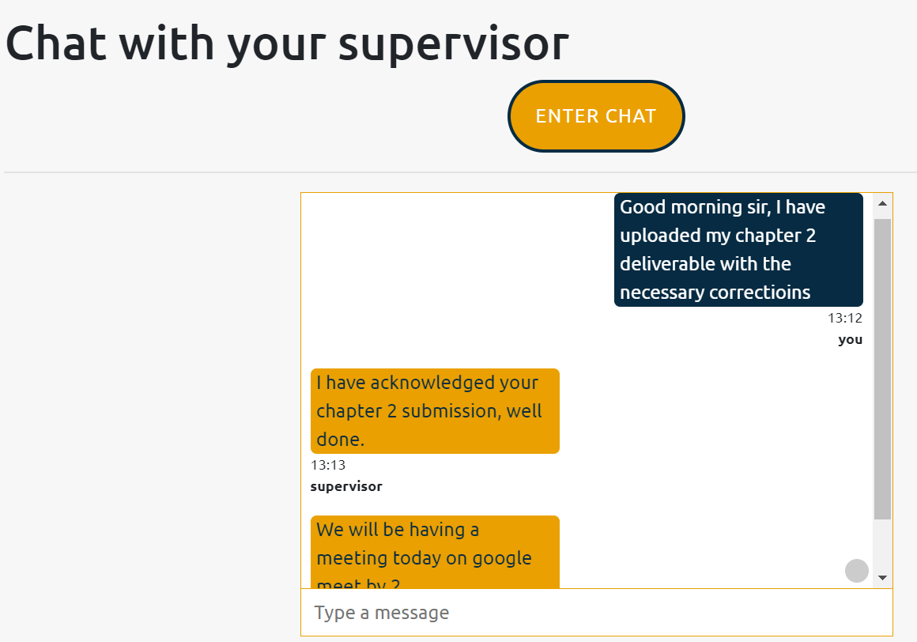
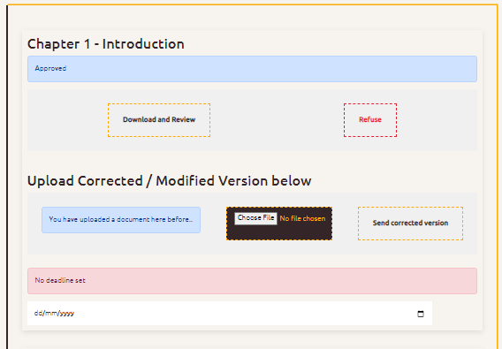
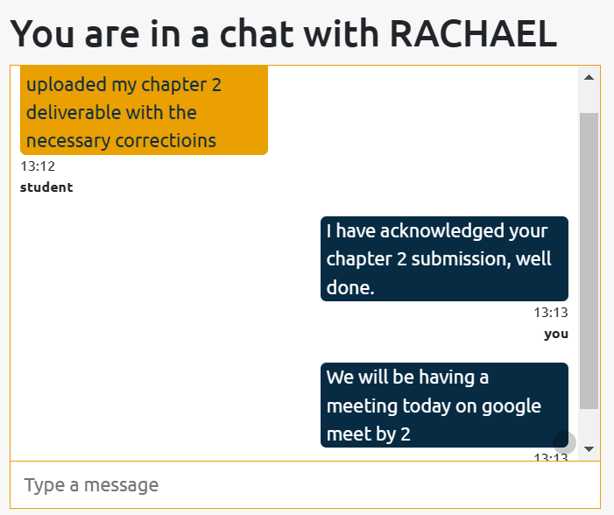
Chat modules
Supervisor’s project management page

Slide 16
Suggestion for future research
Integration with cloud-based storage solutions to enhance data storage and resource accessibility
Implementation of similar systems in other departments for improved project management across the institution
Continuous research and development to keep up with the changing needs and requirements of the academic institution and its stakeholders.

Slide 17
conclusion
The final year project management system successfully addresses the problems associated with manual management of final year projects.
Using a combination of technologies such as React, Node.js, and Express.js, the system provides a robust platform for communication and collaboration between students and supervisors.
Positive feedback from users attests to its effectiveness.
It is recommended that institutions of higher learning adopt the system to simplify and enhance final year project management.

Slide 18
Some literature references
Gomaa, M. S., & Mohamed, S. M. (2020). The Development of an Online Final Year
Projects Management System. Journal of Engineering Science and Technology, 15(3), 1705-1720.
Iruka, J. O., Akinyemi, O. J., & Oyewunmi, O. T. (2019). Challenges and
Opportunities for Implementing a Final Year Project Management System. International Journal of Advanced Computer Science and Applications, 10(10), 99-104.
Olajubu, E. O., Olakanmi, O. E., & Oyewole, S. O. (2017). Design and
Implementation of a Final Year Project Management System for Computer Science Students. International Journal of Advanced Computer Science and Applications, 8(4), 60-66.

